Slide 1
Pen2Code AI-generated Webpages from Hand-drawn Mockups
Final Year Project II (CS-491)

Slide 2


Syed Zain ul Hassan
Supervisor
Co-Supervisor
Kaamla Salman

Slide 3



Group Members
Anusha Saad
Hermain Qadir
Saman Khan
19K-0281
19K-1517
19K-354

Slide 4

WHAT IS PEN2CODE?

Slide 5

An AI-based web application to write boilerplate code
Converts hand-drawn mockup images into HTML webpages

Slide 6
MOTIVATION

Slide 7

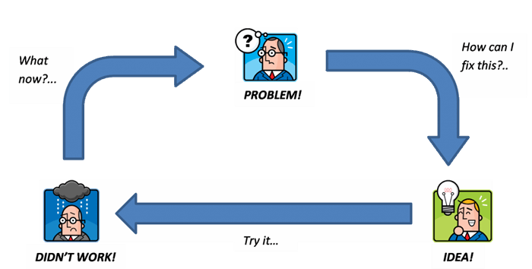


Writing UI code is a redundant and tedious task
Takes up a lot of time that could be utilized elsewhere, i.e. testing, and development phase of SDLC
The process of converting prototype into UI code passes through several iterations because the result does not match with stakeholder’s vision
Makes the process of writing UI code less dependent on a developer’s skills

Slide 8
SIGNIFICANCE

Slide 9
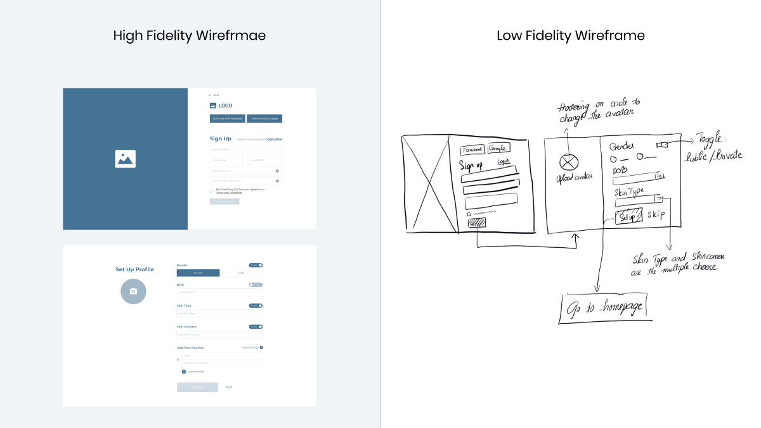
Pen2code will take hand-drawn mockup images as input and produce an HTML file as output containing the UI code.
Bridge the gap that exists otherwise between the stakeholder’s vision and the coder/developer

Slide 10

Description
A web application to automate the time-consuming task of UI coding
Requires a pc and camera to capture an image of a hand-drawn mockup
Pen2code will generate the UI code without any newer tools or technologies needed
It will be an easy-to-use solution for the software development community
Notes:
Part 1
Point 3: No wait for your turn, system always available. Many lazy people not cast their votes
Point 4: Mostly in KPK and Balochistan women not cast their votes, beacuse mans not allowed them to go outside.

Slide 11
WHAT IS A WIREFRAME?

Slide 12

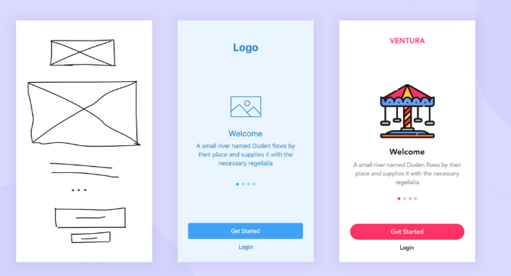
Low-fidelity wireframes
Mid-fidelity wireframes
High-fidelity wireframes
What people are saying
With this app, I’m confident to plan a trip to rural Vietnam
Wendy Writer, CA
Visual translation feels like magic
Ronny Reader, NYC
Translate has officially inspired me to learn French
Abby Author, NYC
Quotes for illustration purposes only

Slide 13
Literature Review
Heuristic-based methodologies
End-to-end methodologies
Object Detection methodologies
Data-driven methodologies
Structural information-based methodologies

Slide 14

Heuristic-based methodologies
The process described in [1] involves extracting elements from an image in a top-down manner using edge detection and median blur. Morphological operations are applied to improve the clarity of the text. Contour detection is used to obtain the bounding box for each element, which is then segmented into separate images. These images are classified using a UI predictor, and the results are combined with bounding box information and features to create a JSON file that stores the hierarchy.

Slide 15
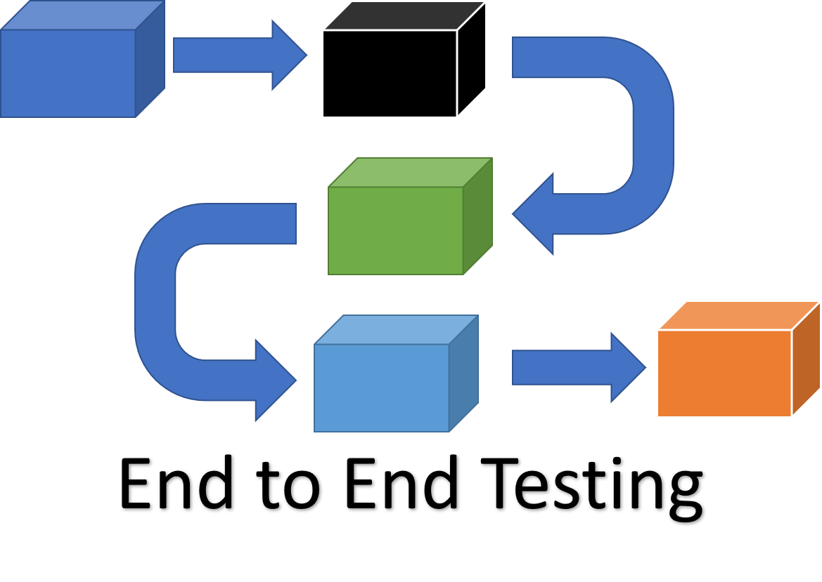
End-to-End Methodology
Beltramelli [2] used three neural networks, including a Convolutional Neural Network and two LSTMs, to generate code from UI images or designs. The CNN processes the image to generate a vision-encoded vector, which is passed through the LSTMs to produce a DSL language-encoded vector. The second LSTM decoder learns the relationship between objects and their DSL tokens to generate code with an accuracy of 77 percent. Initializing a DSL token with a 'start' attribute and providing some DSL context is necessary for valid results.

Slide 16
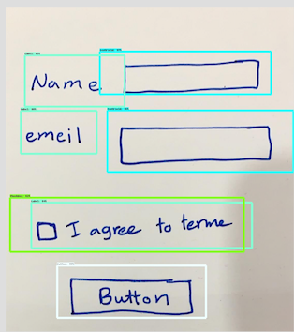
Object Detection Methodology
Suleri et al. [3] developed a solution for detecting UI elements in low-fidelity wireframe sketches using object detection. They manually generated a dataset of 5,096 sketches from 350 participants and annotated it with 125,000 images of 19 UI elements. Their system supports three interaction modes: low-fidelity wireframes, mid-fidelity wireframes, and high-fidelity wireframes. In mid-fidelity wireframes, the system uses an object detector to provide an initial representation, which can be edited by the user. In high-fidelity wireframes, users can also select themes to generate the final code.

Slide 17

Data-Driven Methodology
In [4], two approaches are used for UI element detection: computer vision techniques (such as canny edge detection, contour detection, and morphological operations) and reference to an existing structural file. After detection, a CNN is used for element classification, and a K-Nearest Neighbor algorithm is used to determine the UI layout by comparing it to a large dataset of already extracted UI layouts. The ultimate goal is to find patterns from real-world mobile applications and create code that developers would realistically aim to achieve.

Slide 18
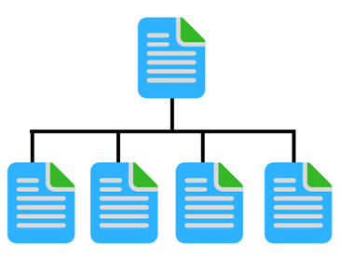
Structural information based Methodology
Using the DOM code, a visual representation of mockups is created where bounding boxes of each element are color coded. A text box has a different color boundary than a bounding box for an image, so it essentially differentiates between a text box and an image first. The DOM from the webpage is used to build a tree of semantic analysis [5].

Slide 19
Methodology

Slide 20
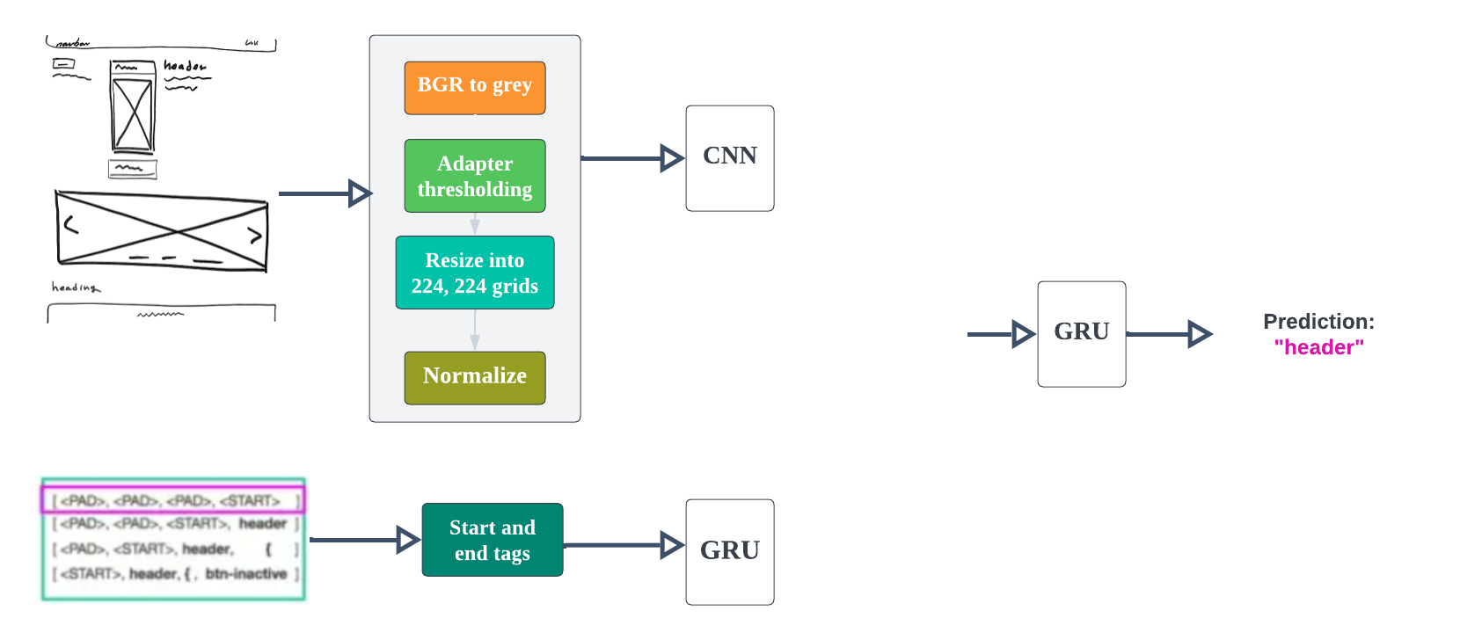
Pipe
line

Slide 21
System Diagram

Slide 22
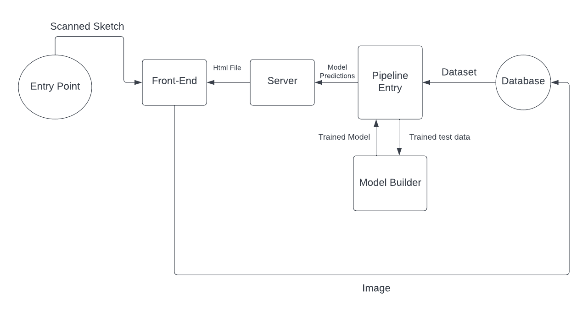

Slide 23
DataSet

Slide 24
What people are saying
Obtained from dataset generator that was developed to solve deep
learning problems of sketch-to-web
With this app, I’m confident to plan a trip to rural Vietnam
Wendy Writer, CA
Visual translation feels like magic
Ronny Reader, NYC
Translate has officially inspired me to learn French
Abby Author, NYC
1500 .jpg images
1500 corresponding .DSL files
Quotes for illustration purposes only

Slide 25
WEB INTERFACE

Slide 26
Overview
Front-end developed using ReactJS
Backend developed using Django

Slide 27
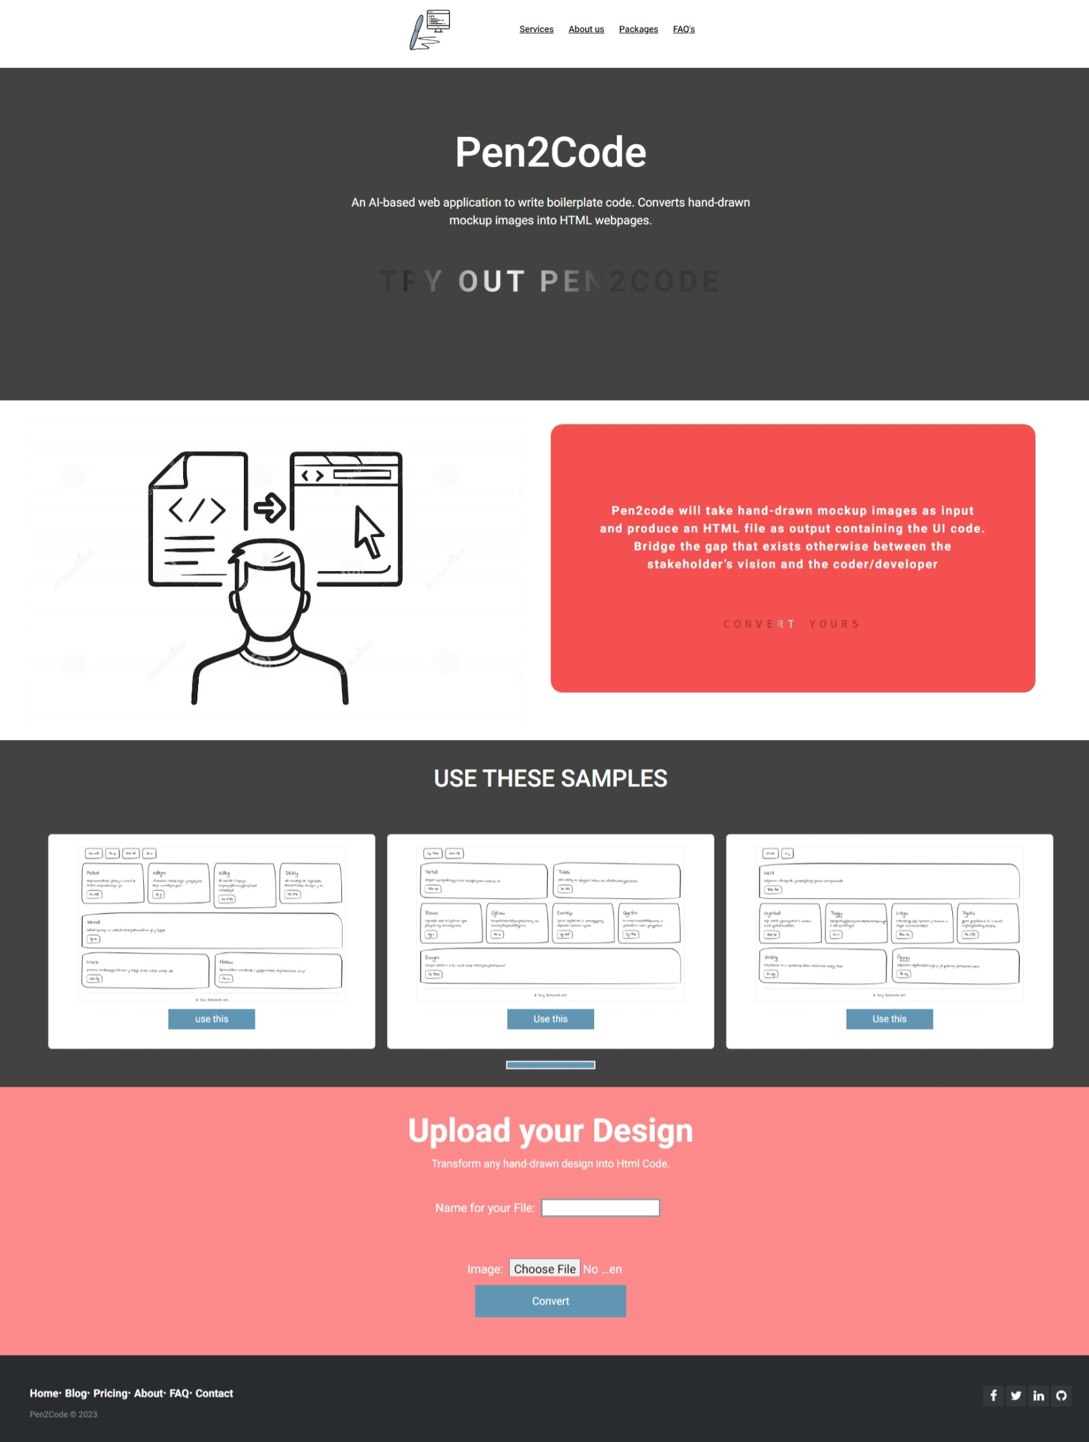
FRONT-END DESIGN

Slide 28
BACKEND
The Back end of the web application, which is based on the Django language.
In Django, the rest framework is used to send pictures from the front-end to the back-end for further model processing.

Slide 29
Overview
Input
Upload your own sketched picture to pen2code
Use given samples
Output
Produces an HTML file as output containing the UI code.

Slide 30
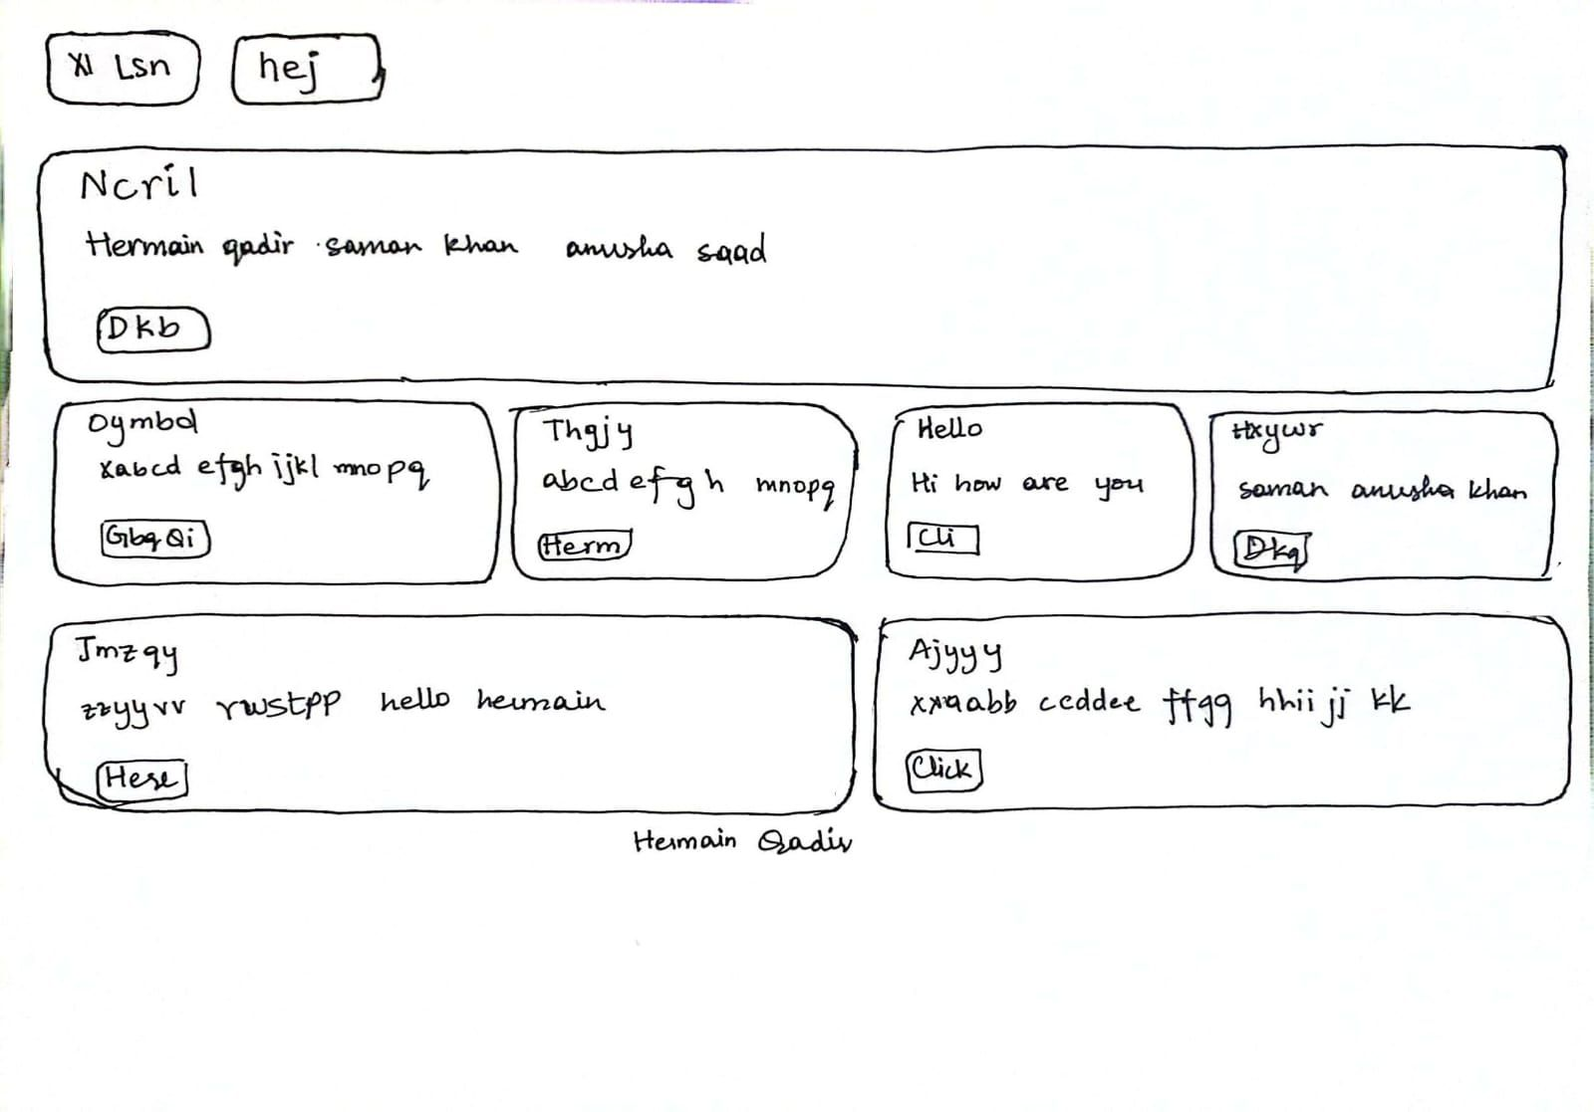
INPUT

Slide 31
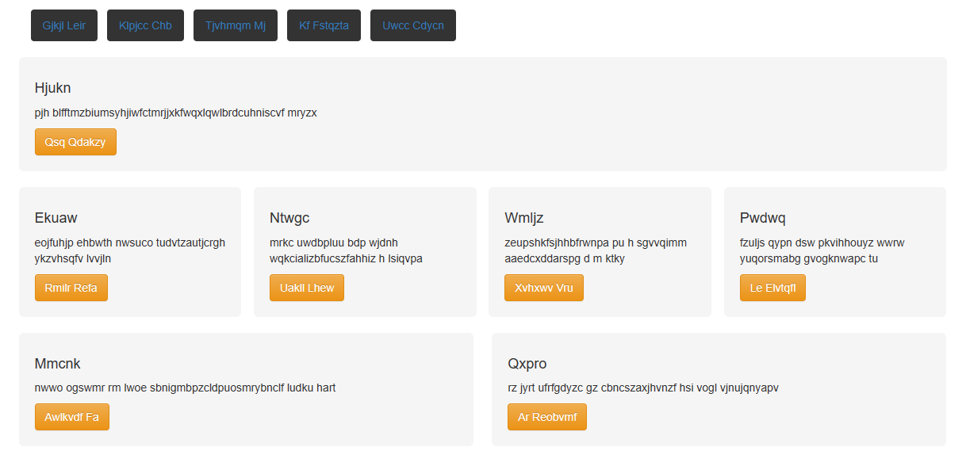
OUTPUT

Slide 32
PHASE 1
Training
Testing of model
Tweaking data

Slide 33
PHASE 2
Developing Back-end
Integrating model with the Web Application
Developing Front-end

Slide 34
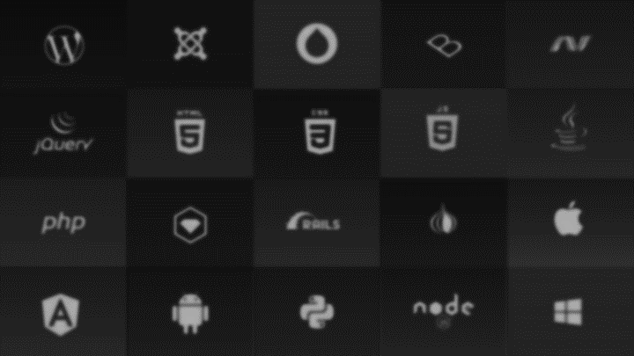

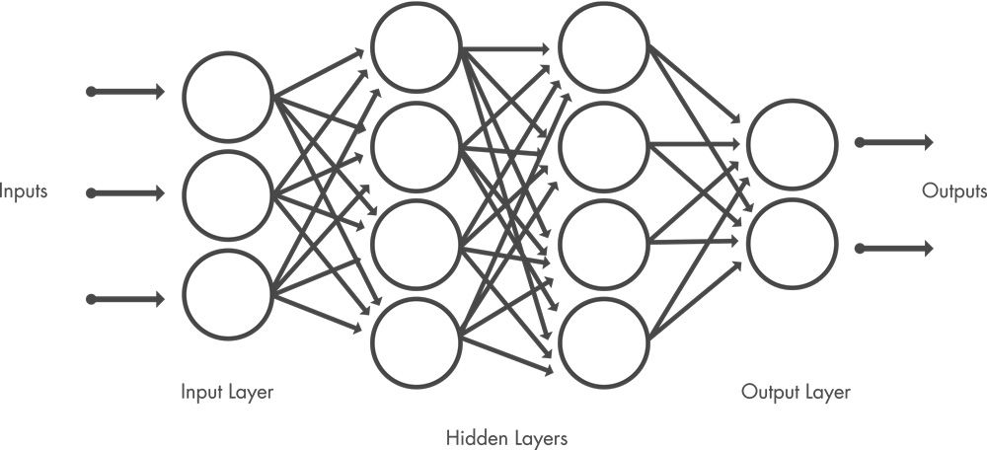




TECH STACK

Slide 35
Gantt
Chart
SAMAN
HERMAIN
ANUSHA
TASKS | SEPTEMBER | OCTOBER | NOVEMBER | DECEMBER
Problem Formulation
Literature Review
Model training phase 1
Model training phase 2
Testing

Slide 36
THINGS TODO IN
FYP-2
TASKS | JANUARY | FEBUARY | MARCH | APRIL | MAY
Website Designing
Website development
Integration of Model
Testing Application

Slide 37
REFERENCES
1. R. Huang, Y. Long, and Xiangping Chen. Automaticly generating web page from a mockup.
Proceedings of the International Conference on Software Engineering and Knowledge
Engineering, SEKE, 2016-Janua, 2016.
2. Beltramelli, T. (2018). Pix2Code: Generating Code from a Graphical User Interface
Screenshot. In Proceedings of the ACM SIGCHI Symposium on Engineering Interactive
Computing Systems, EICS.
3. Sarah Suleri, Vinoth Pandian Sermuga Pandian, Svetlana Shishkovets, and Matthias Jarke.
Eve. In Extended Abstracts of the 2019 CHI Conference on Human Factors in Computing
Systems - CHI EA ’19, pages 1–6, New York, New York, USA, 2019. ACM Press.
4. Kevin Patrick Moran, Carlos Bernal-Cardenas, Michael Curcio, Richard Bonett, and Denys
Poshyvanyk. Machine Learning-Based Prototyping of Graphical User Interfaces for Mobile
Apps. IEEE Transactions on Software Engineering, 5589(May):1–26, 2018.
5. Mohammad Bajammal, Davood Mazinanian, and Ali Mesbah. Generating reusable web
components from mockups. Proceedings of the 33rd ACM/IEEE International Conference on
Automated Software Engineering - ASE 2018, pages 601–611, 2018.

Slide 38

Contact
Anusha Saad
k190281@nu.edu.pk
Hermain Qadir
k191517@nu.edu.pk
Saman Khan
k90354@nu.edu.pk
THANK YOU!
ANY QUESTIONS?

